Slide 1
How Technology can deliver
Duty of Care in a Crisis
Oct 2018
Duty of Care: Protecting the security, well-being, and safety of your personnel.
Richard Stephenson CEO - YUDU Sentinel

Slide 2
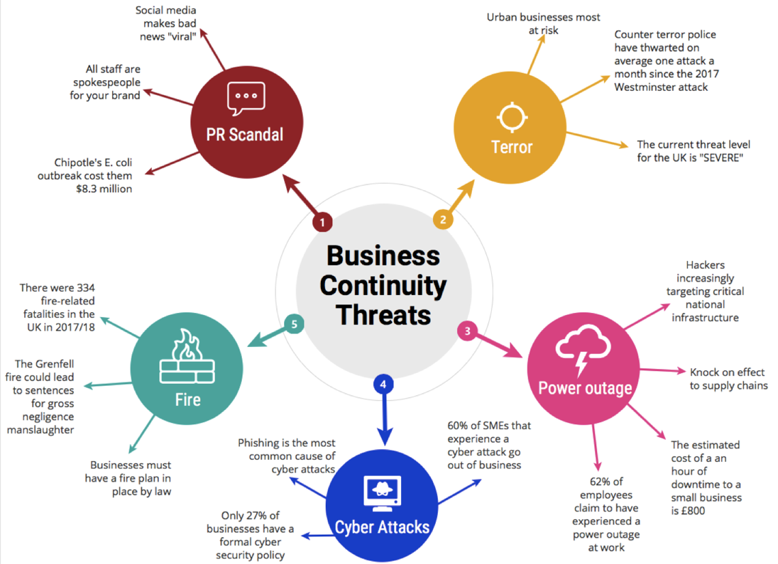
A World of Threats

Slide 3
ISO 22330 - The people Aspects of BC
Preparation through awareness, analysis of needs, and learning and development;
Coping with the immediate effects of the incident (respond);
Managing people during the period of disruption (recover);
Continuing to support the workforce after returning to business as usual (restore)

Slide 4
Duty of Care in an incident
“An employer can be deemed to have breached their duty of care by failing to do everything that was reasonable in the circumstances to keep the employee safe from harm.”
What is “Reasonable?”

Slide 5
What do we do today?
Fire Alarms - It is a statutory duty: Evacuation
Companies have a legal obligation to have evacuation plans and ensure a building is safely evacuated - the role of the fire marshal.
Consider: false alarms, deliberate activation, counter instructions & evacuation risks.
BUT is it reasonable to do more?
Invacuation, lockdowns, safe spaces.
Ensure staff at meetings or lunch, travellers to work, home workers & lone workers are safe and informed.

Slide 6
What we SHOULD and CAN do today?
Immediate notification of what to do to stay safe
Conduct a positive check people are safe
Track down non-responders
Communicate with those at risk
Provide staff with access to key numbers to call.
Provide staff with detailed information and instructions
Provide regular updates throughout the incident life.

Slide 7
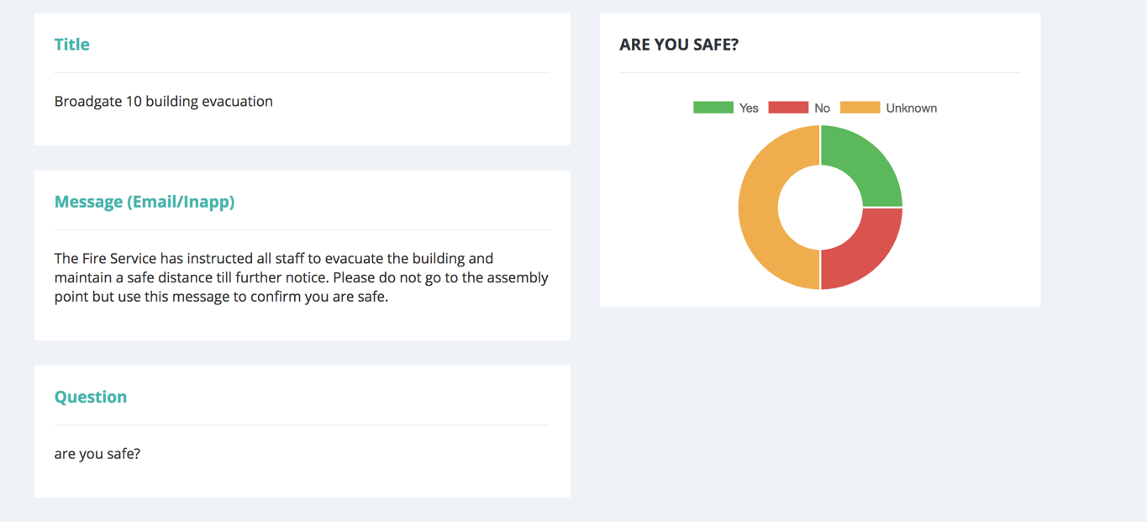
Yes/no answers - Fast evaluation.
Yes/No answers give immediate picture.
Focusses resources on the exceptions and non responders

Slide 8
What are the Technology Challenges?
Loss of Cell phone signal or overload of networks
People using different devices (desk, mobile, fixed line)
Overload of sms and instant messaging alerts
Telcos all having different capabilities and rules
Incomplete and degradation of return sms messages
No access to incident control rooms
Occasional nature of incidents leading to unfamiliar tech
Information overload for incident teams
Clutter and deluge of Social Media information
Humans ability to forget their training
Humans propensity to “wing it”.

Slide 9
Communications: The need for multiple channels
Challenge 1 - Getting people’s attention: Location
At the desk…………email & work phone
Away from the desk………..SMS and in-app messaging
Challenge 2 - Getting people’s attention: Alerts
Phones set to silence
Work phone voice alerts
SMS alert sounds
Custom sounds & push notification alerts via the app
Challenge 3 - Group conversations
Dial in pins, call numbers, invitations.

Slide 10
Documentation: The need for immediate access
Challenge 1 -Ensuring documents are always up to date
Push to all user the latest updates
Challenge 2 - Ensuring documents can be read if there is no signal.
Document library available offline.
BC DR and Comms plans
Crisis scenario Playbooks
Action list
Video instructions.
Challenge 3 - Ensuring documents are only seen by specific people
Permissions management tools for documents

Slide 11
The duty to inform: developing Security Culture
Security has to be company-wide
Apps can keeps security front of mind. Think CYBER!
Apps has a reference library for all situations and plans
Apps can deliver regular push notification to groups….Keeps it alive with weekly polling.

Slide 12
Ebbinghaus Forgetting Curve
Learning
Forgetting
Apps deliver offline Documents & Action Cards
Normal Forgetting
Normal Learning
Days
Source: Mark Von Rosing : 2015 Global University Alliance

Slide 13
Staff are now all publishers
Harness Them
Beware of Vacuums: Keep them informed

Slide 14
Immediacy & Independence
Tunnel Vision in a Crisis
Avoided by:
Training
Immediate access to key contacts
Immediate access to plans
Immediate access to action lists
Simple, clear user-interface

Slide 15
Sentinel Summary
Broadcast Centre
Mass notification via SMS, email, in-app message and voice.
Two-way Getting people’s attention: Location
polling to yes/no questions.
Temporary users can be added, contacted and deleted – ideal for hotel guests.
Document Centre
Offline access to vital documents.
Admins can edit, highlight and extract only relevant pages to share en masse.
PhoneView makes documents easy to read on any device.
Directory
Database of all employees.
Easy to set up and keep updated with an API to your HR database.
GDPR compliant – users have control of their own information.
External contacts can include suppliers, neighbouring businesses, emergency services.

Slide 16
Sentinel Summary
Action Cards
Bespoke content created by security consultants
Instructions to a range of scenarios pre-loaded onto staff phones.
Contact details for the appropriate manager made easy to access.
Content Delivery
KTRS Power to respond
Social media and emergency services curated feeds
Templated action lists
Playbook templates
Secure Instant Teleconferencing
Set up conference calls instantly.
No PINS or dial-in numbers.
More secure – only those invited can join.

Slide 17
Contact: info@fortressas.com
Call: +44 (0) 20 3858 0099
http://fortressas.com/fortress-sentinel/

